Slide 1
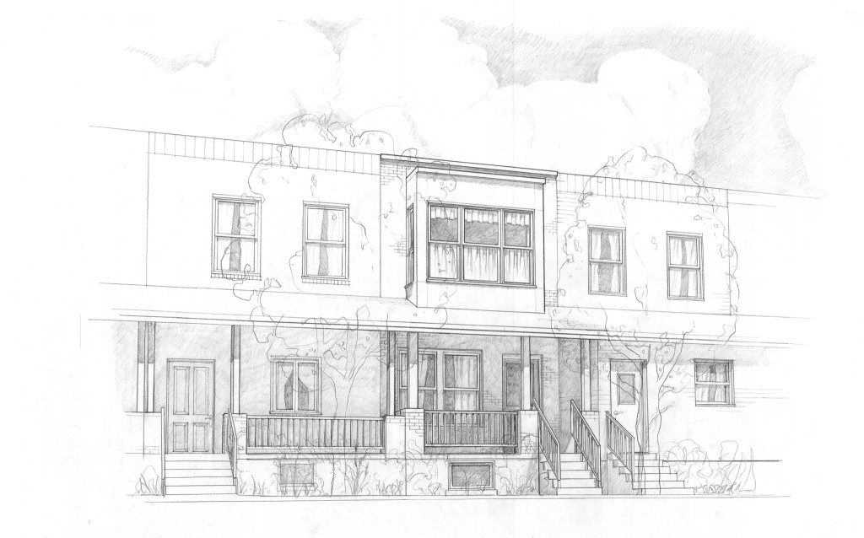

Slide 2

PHILADELPHIA
ROW HOUSE
COMMUNITY
DEVELOPMENT
PROGRAM
Prepared Under the Supervision
of Professor Daniels
New York University
LUCY CABRERA ANTHONY CALVANO TAO CHEN SHAUN GAVIDIA HO-KAI HUANG

Slide 3

“Philadelphia is a city of rowhouses. Their constant revitalization and adaptation illustrates the viability of the city. We don’t cook in basement fireplaces or use backyard privies as the earliest rowhouse residents did, but the houses have proven to be so adaptable that we’ve been able to make them congenial to the 21st century, even with vastly different family structures, social ideals, and technology.”
GARY J. JASTRZAB,
Acting Executive Director Philadelphia City Planning Commission

Slide 4
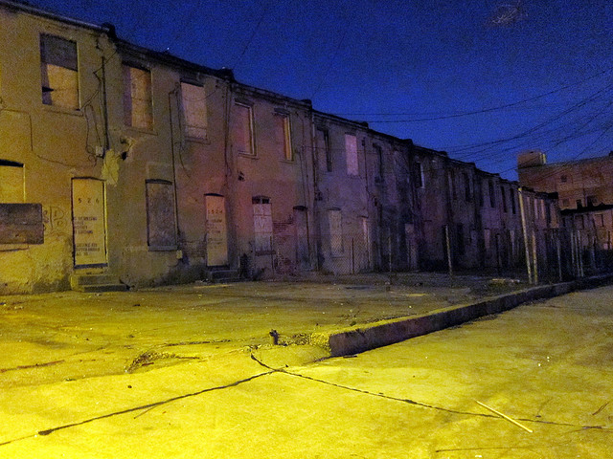

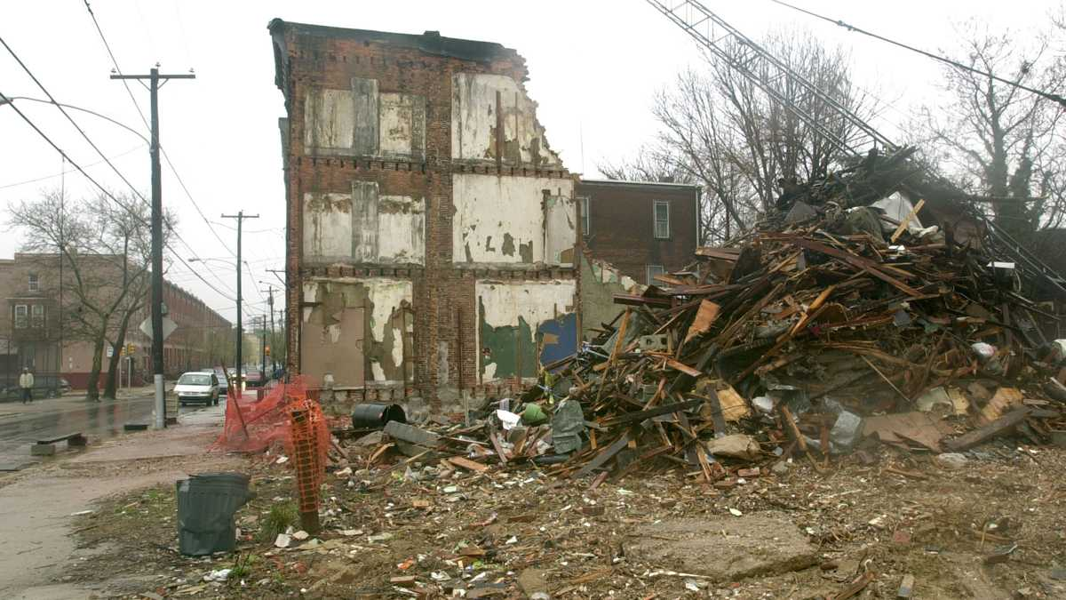
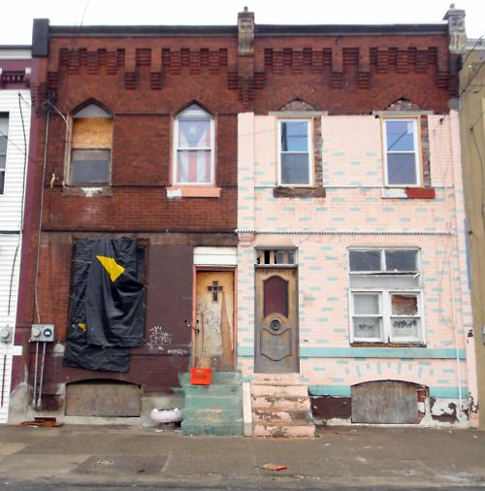
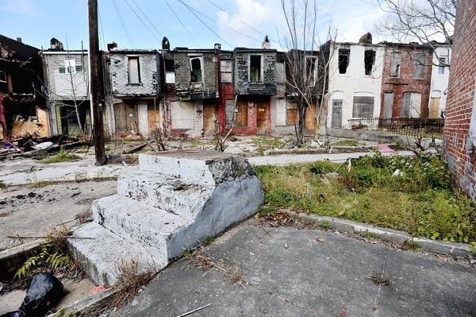
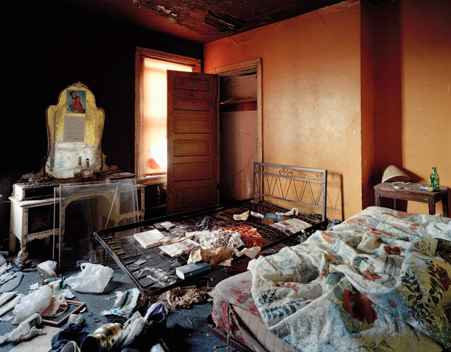
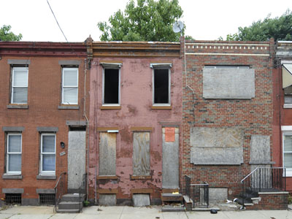
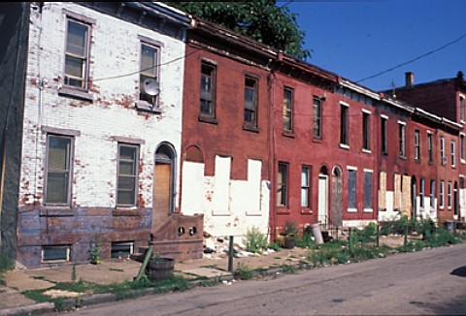
“Philadelphia is a city of rowhouses. Their constant revitalization and adaptation illustrates the viability of the city. We don’t cook in basement fireplaces or use backyard privies as the earliest rowhouse residents did, but the houses have proven to be so adaptable that we’ve been able to make them congenial to the 21st century, even with vastly different family structures, social ideals, and technology.”
GARY J. JASTRZAB,
Acting Executive Director Philadelphia City Planning Commission
Photo Credit Jeffrey Stockbridge

Slide 5
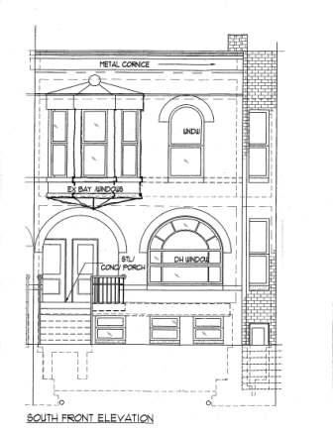
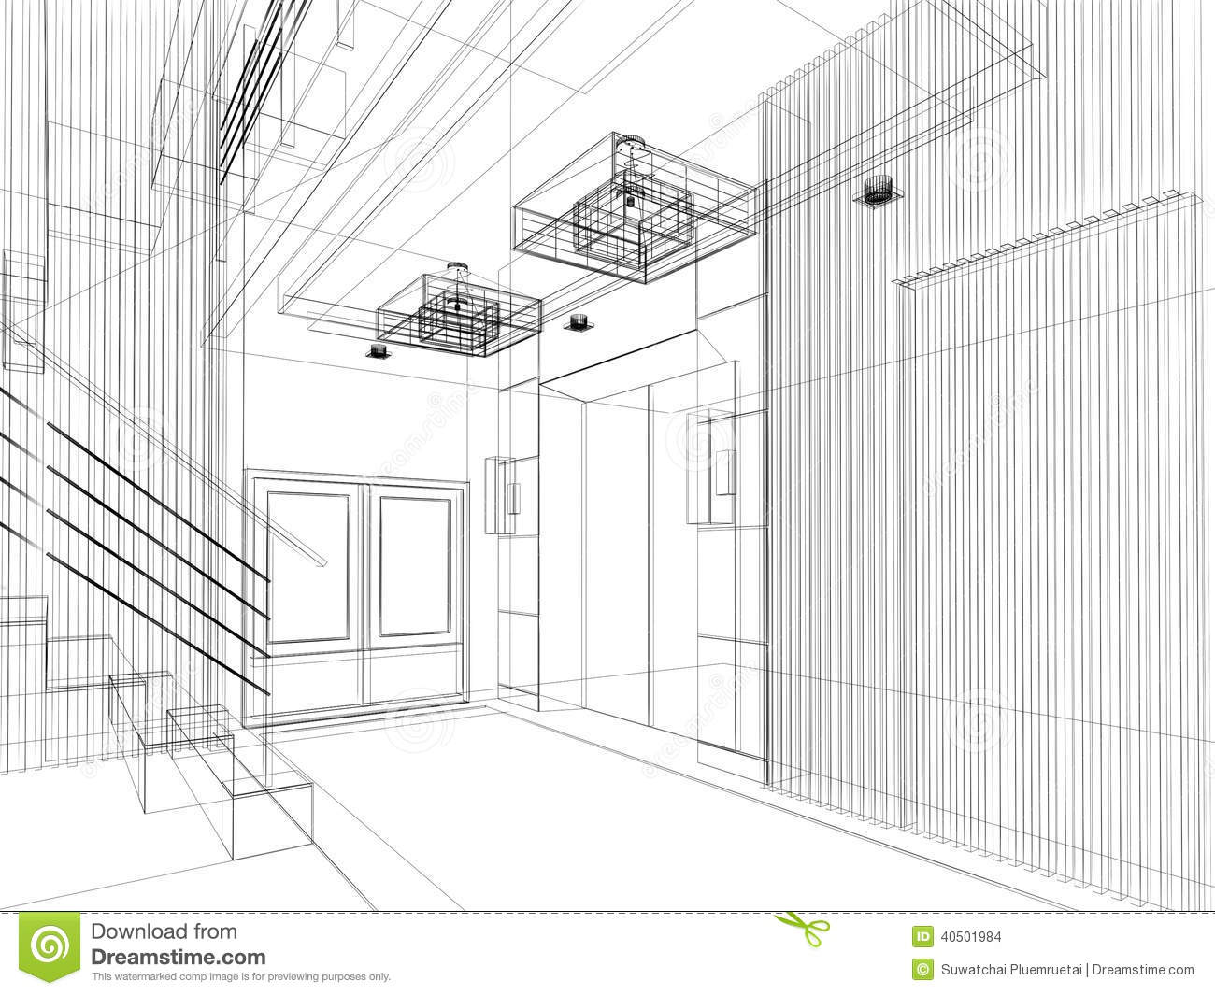
OUR PROPOSAL

Slide 6
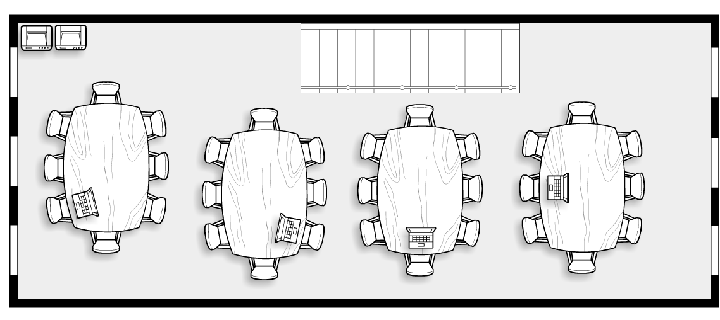
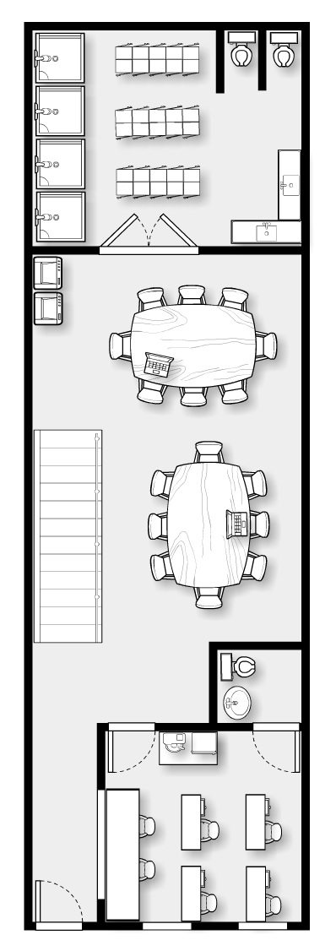
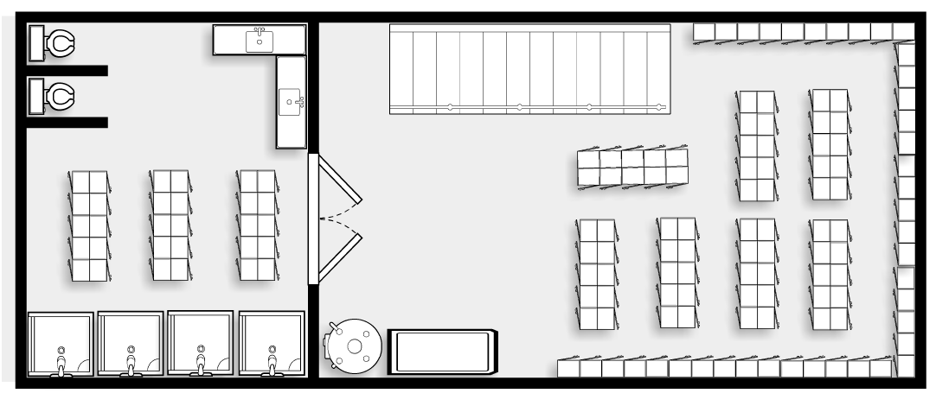
2ND FLOOR
1ST FLOOR
BASEMENT

Slide 7
2ND FLOOR
1ST FLOOR
BASEMENT

Slide 8
2ND FLOOR
1ST FLOOR
BASEMENT

Slide 9

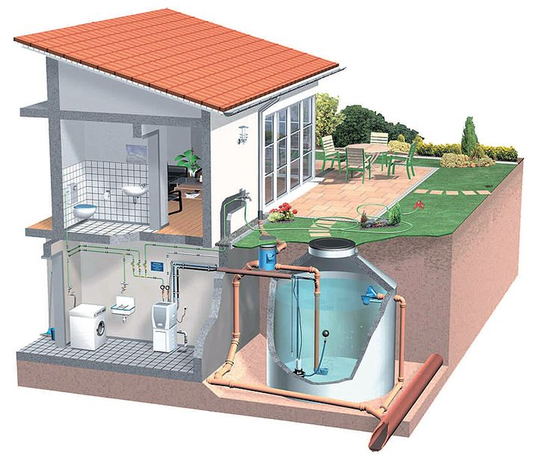
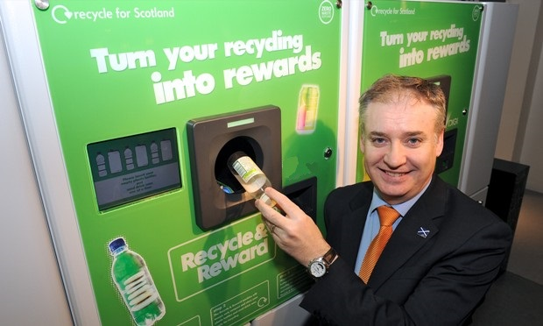
TRIPLE BOTTOM LINE
PLANET
ROOFTOP SOLAR PANELS
WATER RECLAMATION
NEIGHBORHOOD RECYCLING

Slide 10








TRIPLE BOTTOM LINE
PEOPLE
COMMERCIALLY ZONED MAILBOXES
LOW COST OFFICE SPACE RENTAL
GRANT/LOAN ASSISTANCE
REDUCES AREA UNEMPLOYMENT
INCREASE SURROUNDING LAND VALUES
PARTNERED WITH VARIOUS LOCAL CHARITIES
  SUITS FOR VETERANS
  DRESS FOR SUCCESS

Slide 11
TRIPLE BOTTOM LINE
PROFIT
SPLIT PROFIT COMPANY/ NON-PROFIT COMPANY
PROFIT COMPANY OWNS/MAINTAINS PROPERTY & BUILDING
  ALLOWS FOR ENVIRONMENTAL INCENTIVES/PROFIT
NON-PROFIT SECTOR OPERATES COMMUNITY CENTER
PROJECTED MAILBOX REVENUE:
  $5/MONTH PER UNIT
  MONTHLY TOTAL REVENUE = $2,500
PROJECTED OFFICE SPACE REVENUE:
  $100/MONTH PER UNIT
  MONTHLY TOTAL REVENUE = $9,600
ESTIMATED BREAK-EVEN POINT
  45% - 55% OCCUPANCY

Slide 12






RAISING CAPITAL

Slide 13
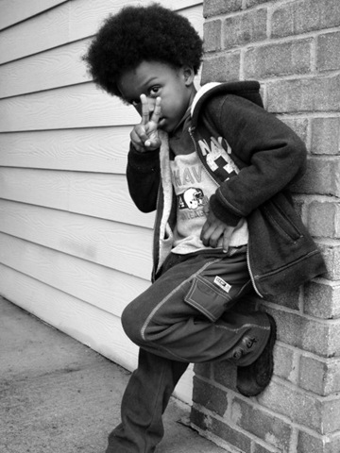
PHILADELPHIA
ROW HOUSE
COMMUNITY
DEVELOPMENT
PROGRAM
THANK YOU FOR YOUR
SUPPORT AND
CONTRIBUTION
LUCY CABRERA ANTHONY CALVANO TAO CHEN SHAUN GAVIDIA HO-KAI HUANG

